Slide 1
Lecture 8
State & Props
Props are used to pass data from a parent component to a child component, while state is used to manage data within a component.
Props are immutable and cannot be changed within a component, while state is mutable and can be updated using the setState function.
Props are passed down from the parent component and are read-only within the child component, while state is only accessible within the component where it is defined.
Props can be used to customize the behavior or appearance of a component, while state is used to keep track of information that can change over time.

Slide 2
Props in React JS
function ChildComponent(props) {
return <div>{props.message}</div>;
}
function ParentComponent() {
return <ChildComponent message="Hello, World!" />;
}
You can also use in app.js & passes props to components.

Slide 3
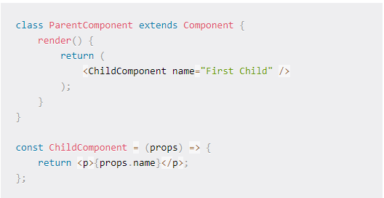
How to pass data with props

Slide 4
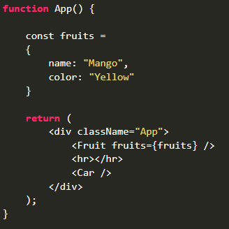
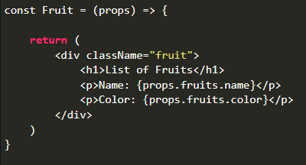
You can use object as props

Slide 5
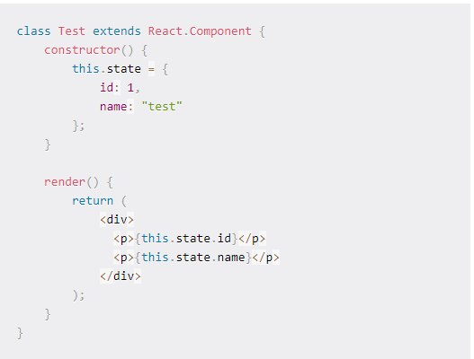
How can we use State

Slide 6
Example - State In React Js
import React, { useState } from 'react';
function Counter() {
const [count, setCount] = useState(0);
function handleClick() {
setCount(count + 1); }
return (
<div>
<p>Count: {count}</p>
<button onClick={handleClick}>Increment</button>
</div>
);}

Slide 7
Class Components
A class component must include extends React.Component
It also requires render() method
Example :
class ABC extends React.Component {
render(){
return <h3>My Class Component</h3>
}
}

Slide 8
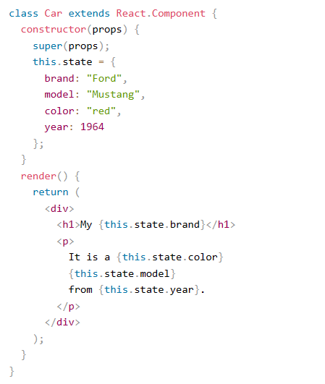
Using State Object

Slide 9
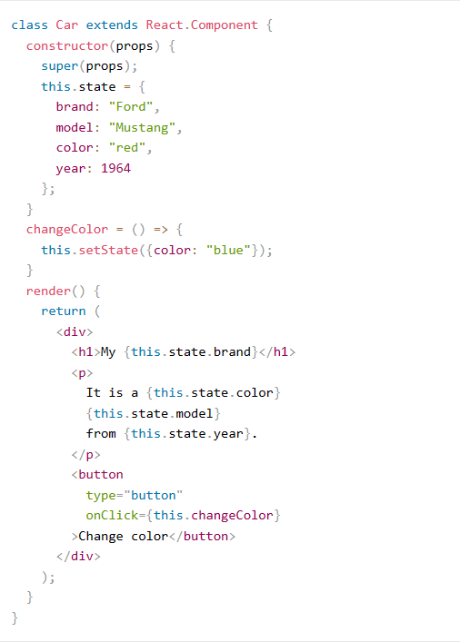
Changing State Object Value
You can use this.setState()

Slide 10
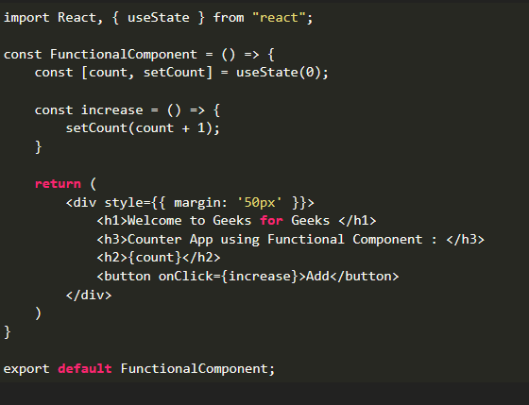
Functional Components
A stateless component, also known as a functional component

Slide 11
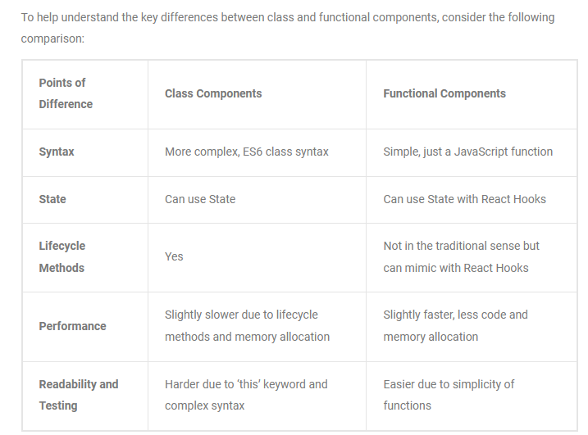
Difference B/w Function & Class Components

Slide 12
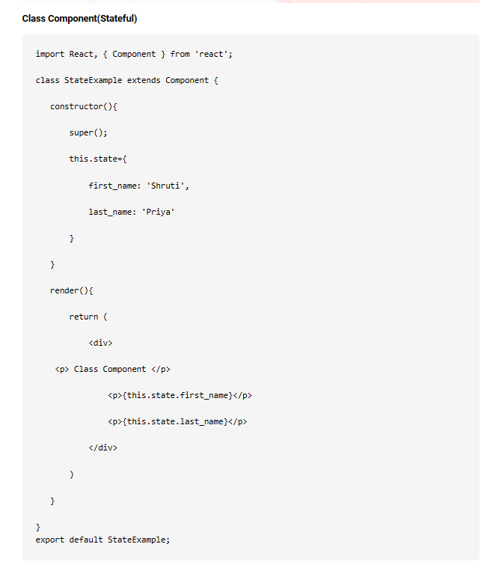
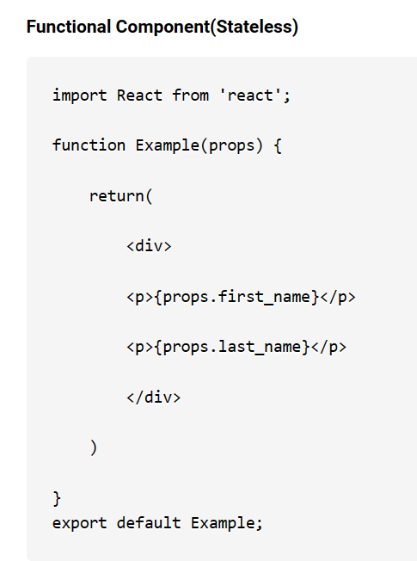

Slide 13
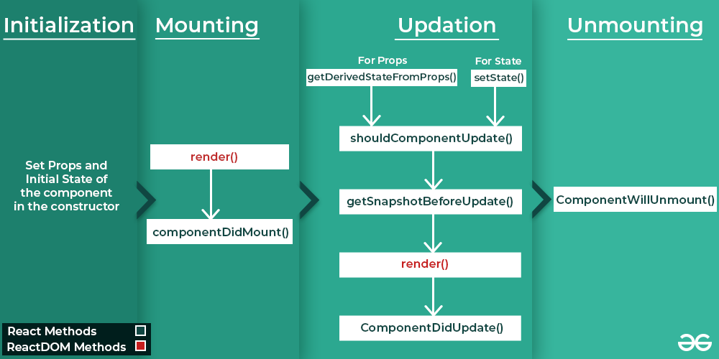
Component Life Cycle

Slide 14
Mounting Phase
Constructor()
It is called when the component is first created.
To initialize the component’s initial state
Bind the methods using bind()
getDerivedStateFromProps()
It is used to update component’s state based on changes in props before render
Static getDerivedStateFromProps(props , state)
Render()
componentDidMount()
Once component has been mounted into the DOM, it is called

Slide 15
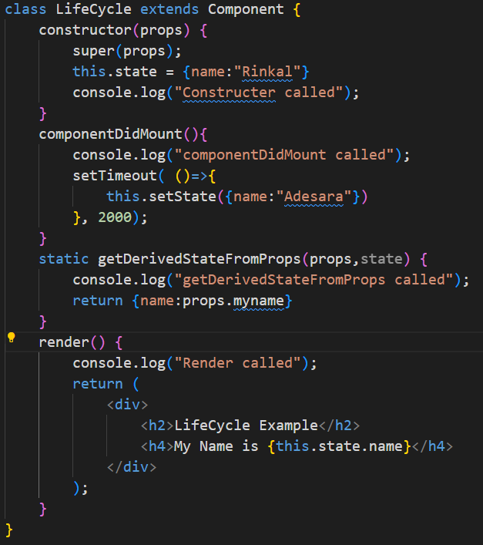
Example
App.js
<LifeCycle myname="Testtt"/>
LifeCycle.js

Slide 16
Updation Phase
shouldComponentUpdate()
It is called before a component is called.
2 arguments : nextProps, nextState
This method returns a boolean value that determines whether the component should update or not.
componentWillUpdate()
It is called before a component is updated.
2 arguments : nextProps, nextState
It is used for API calls.
componentDidUpdate()
It is called after a component has been updated and re-rendered.
2 arguments : prevProps, prevState.
It is used to perform additional operation when the component's props or state have changed

Slide 17
Updation Phase
getSnapshotBeforeUpdate()
It is called before component’s UI is updated
It allows to capture value about current state of UI
Unmounting Phase
componentWillUnmount()
when a component is being removed from the DOM (Document Object Model)
All of its state and props are destroyed.
We can also clearing some data like canceling timers,removing event listeners.

Slide 18
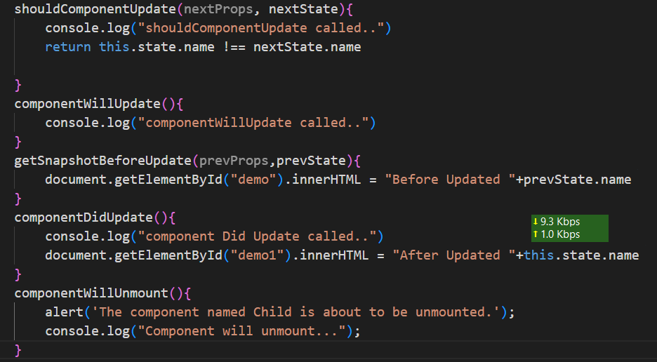
Example

